Slide 1
How to Communicate Your Technical Background to Industry
Dr. Gabrielle Thomas
Group Leader Marketing
Munich, 01.10.2026
Notes:
(a) Ingredients and recipes for precision measurements
(b) What we can learn from frequencies
(c) Ultrastable lasers and frequency combs - a perfect match
(d) A journey through the electromagnetic spectrum

Slide 2
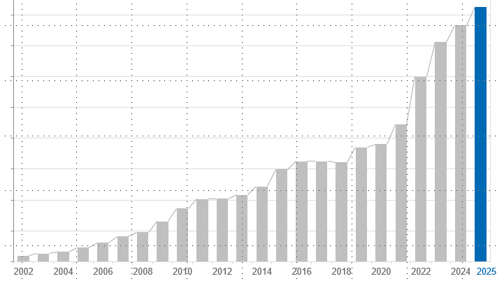
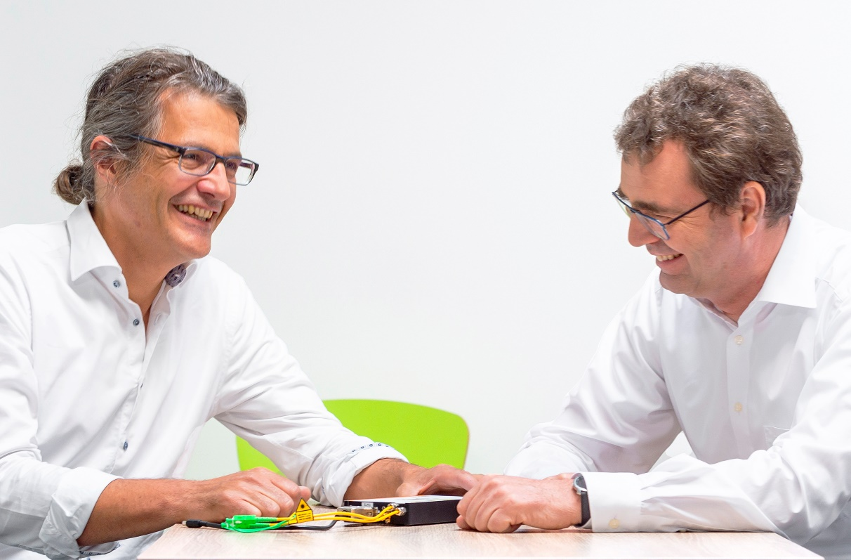
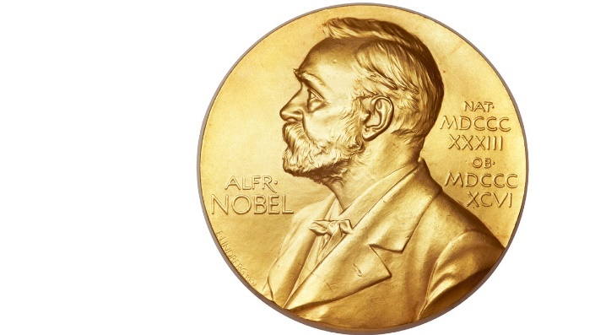




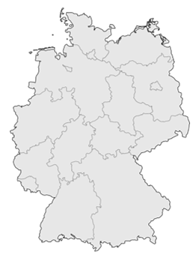
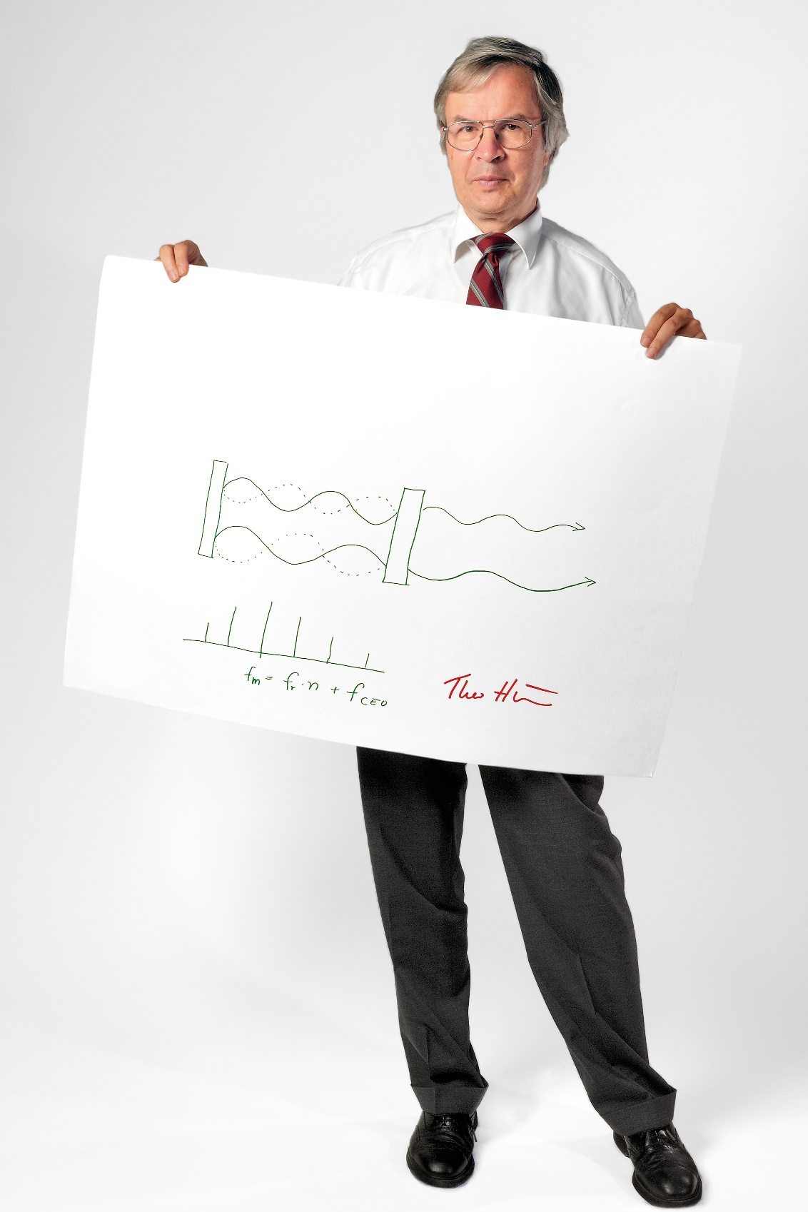

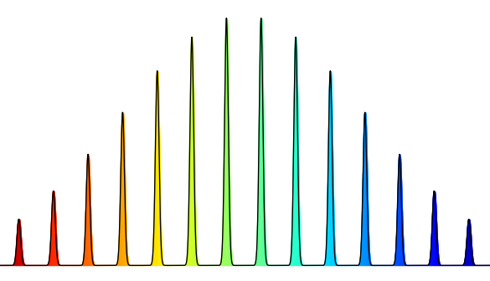

From Pioneers to Global Market Leader in Optical Frequency Combs
MENLO SYSTEMS
2001
Spin-off from the Max Planck Institute for Quantum Optics
2005
Nobel Prize awarded to Theodor Hänsch jointly with John Hall, and Roy Glauber
"for their contributions to the development of laser-based precision spectroscopy, including the optical frequency comb technique".
2026
Customers around the globe
No.1 in Optical Frequency Combs and Ultrastable Laser
225 employees, growing
4 locations
Menlo founders Michael Mei & Ronald Holzwarth
& Prof. Theodor Hänsch

Slide 3
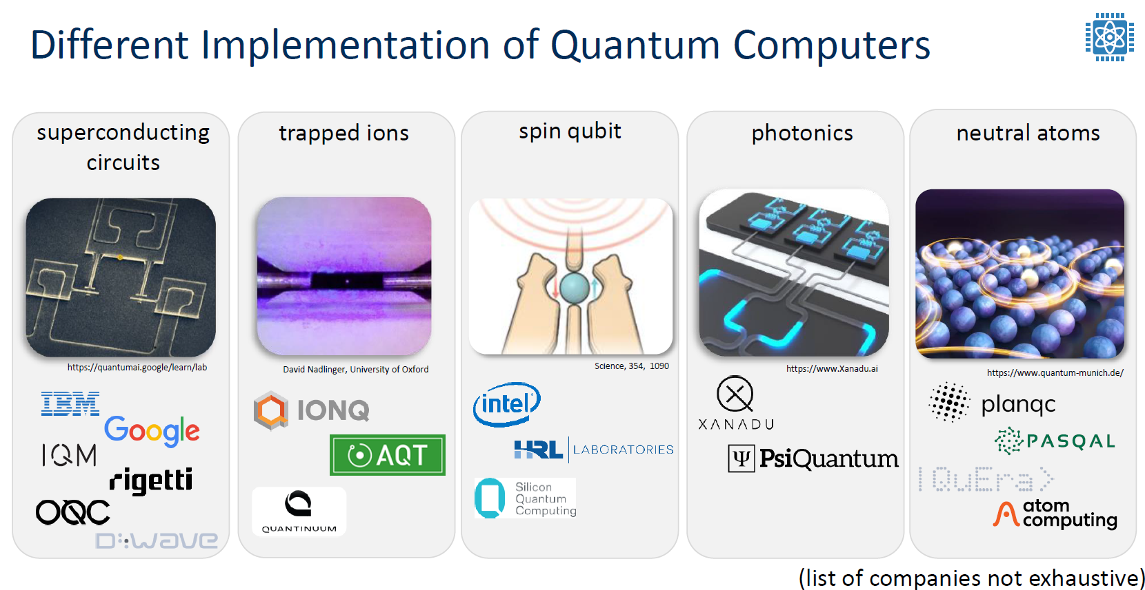
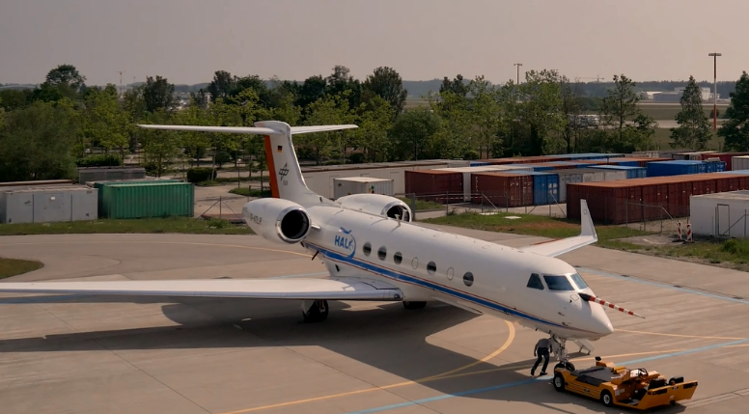


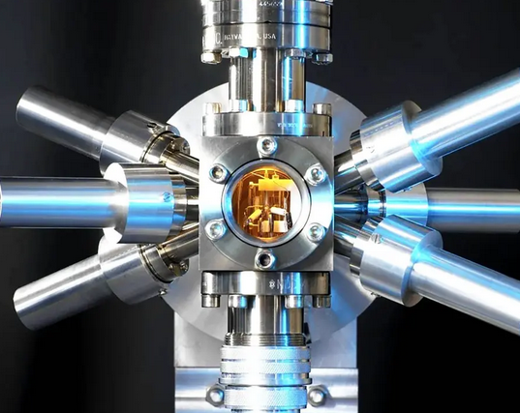
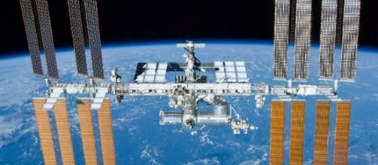
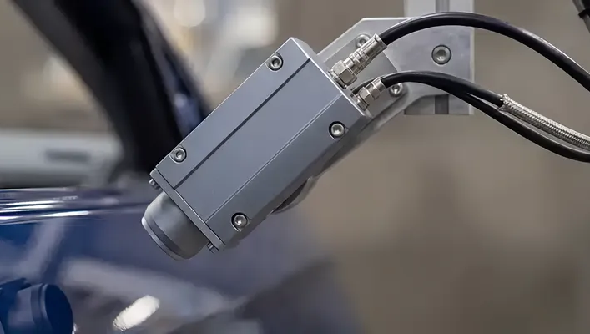
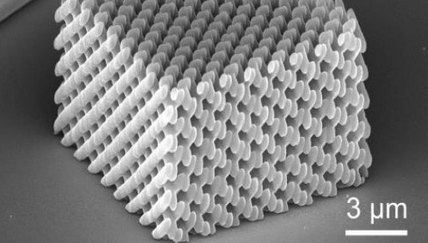
Applications
Markets and Industries
Quantum Technology & Clocks
Spectroscopy & Sensing
Radar, Positioning, Navigation, Timing
Quality Inspection
Microfabrication
Timing Solutions
ASOPS Systems
Imaging & Life Science
S
Notes:
Imaging & Life Science: Multi-photon fluorescence imaging, THz non-destructive testing, near-field THz microscopy, neuroscience
Spectroscopy & Sensing: Industrial process control, molecular sensing, LIDAR calibration, THz gas sensing
Quantum Technology: Optical lattice clocks, quantum simulation, quantum computation, quantum sensing
Quality Inspection: non-destructive material testing, food inspection, paint layer inspection
Microfabrication: 3D micro-printing, integrated photonics
Positioning, Navigation & Timing: time & frequency dissemination, optical fiber links, geodesy, GNSS

Slide 4
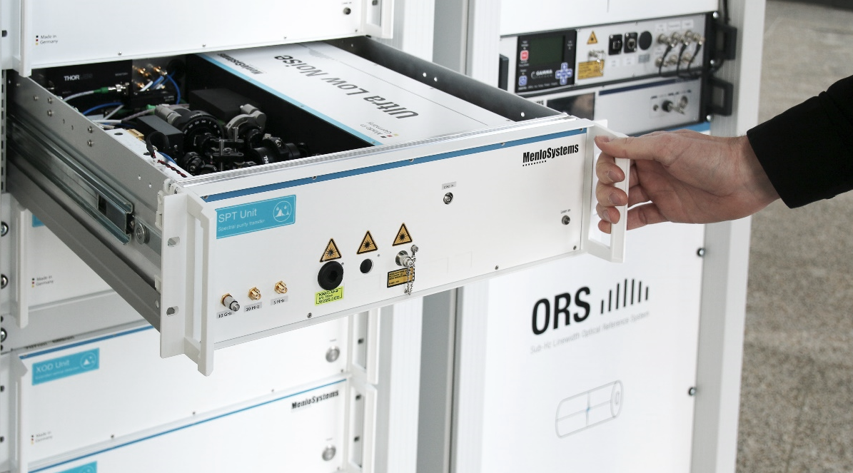
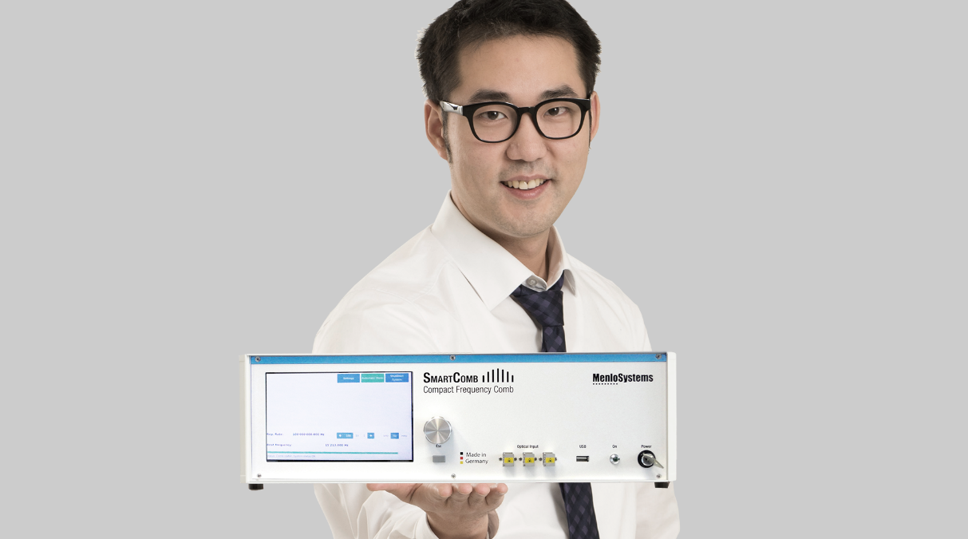
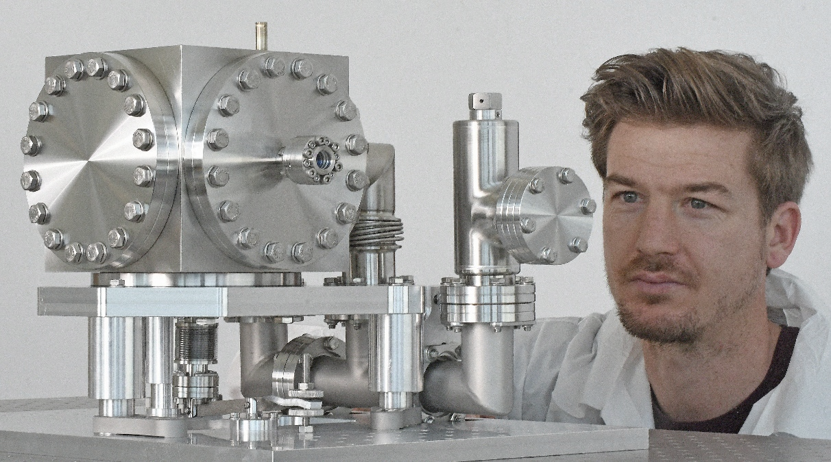
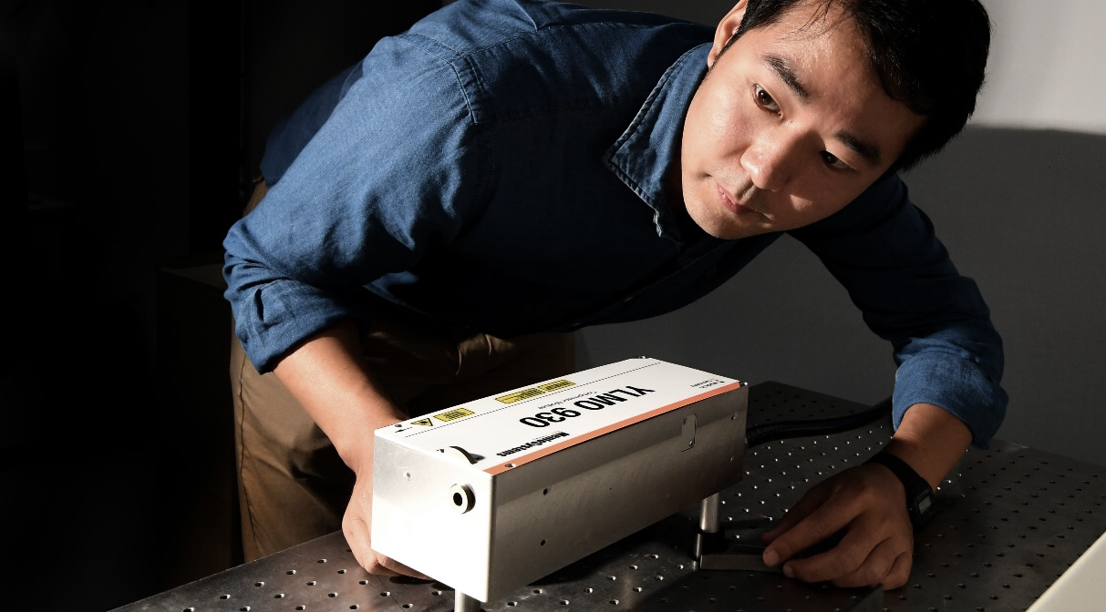
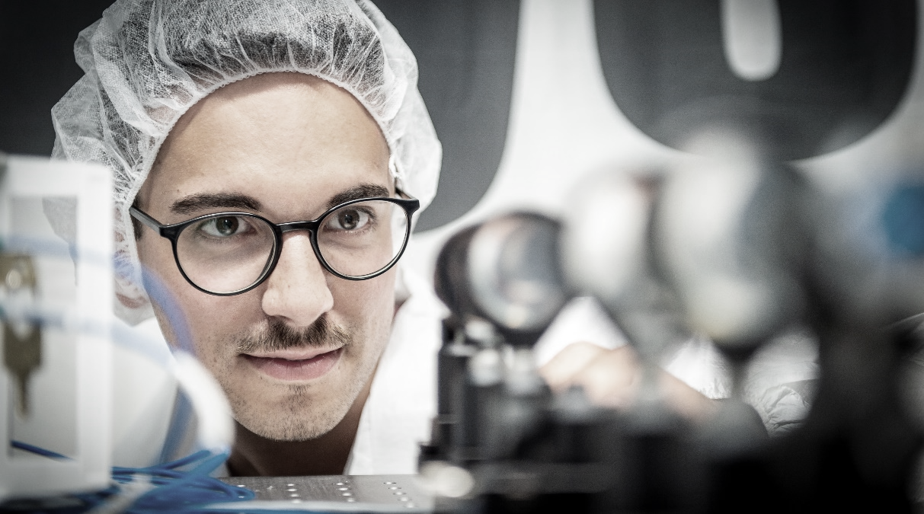
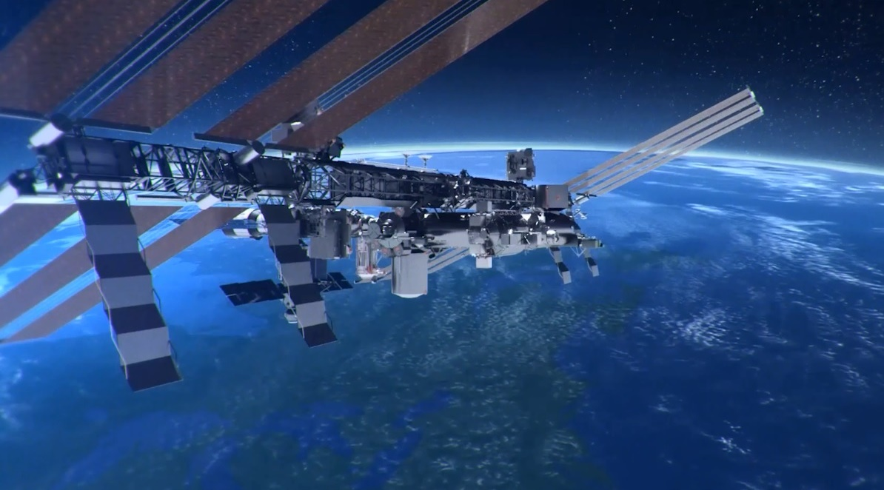
Products and Technology
Precision in Photonics. Together we shape a sustainable future.
Quantum Laser Systems
Optical Frequency Combs & Microwaves
Ultrastable Lasers
fs Fiber Lasers
Terahertz Solutions
Timing Solutions
ASOPS Systems
Solutions for Space
S

Slide 5
How to Communicate Your Technical Background to Industry
CV
Recruiter has limited time to read the CV
  Precise but short is better
  Most important skills, experiences, and aspects should jump out of the page
  Clarity and structure are important, not so much text
Include current role / employment situation
Don‘t be afraid to include breaks in your career, make the CV seamless
Different countries have different standards when it comes to photos on CVs – check what is relevant for you

Slide 6

How to Communicate Your Technical Background to Industry
interview
Pre-interview: inform yourself about the format (but usually the recruiter will tell you this beforehand)
Important to show your relevance to the role
Prepare to say a little something about yourself
Consider a situation or project that you were involved in, and what your impact was
  STAR Method: Situation, Task, Action, Result
Prepare some questions that are important to you
Show interest in the employer and the position
It is usually obvious to the interviewer if you are unprepared
Notes:
As researchers and engineers, we are used to talking about our technical work in great detail. We know our methods, our experiments, and our results. But when we apply for a job in industry, we need to communicate more than just our research topic. We need to show what we can do, how we solve problems, and how our experience could be relevant to a company.
Describe the situation or problem briefly and precisely, explain your specific task or role, or responsibility, list the specific steps and actions you took, describe the outcome success or lessons learned

Slide 7
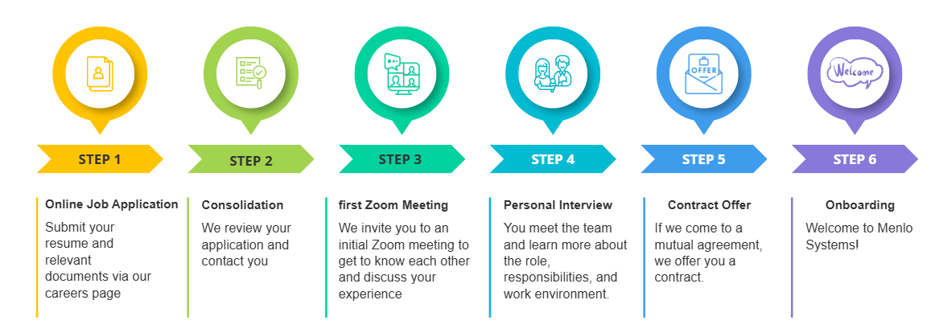
How to Communicate Your Technical Background to Industry
Application process at Menlo

Slide 8

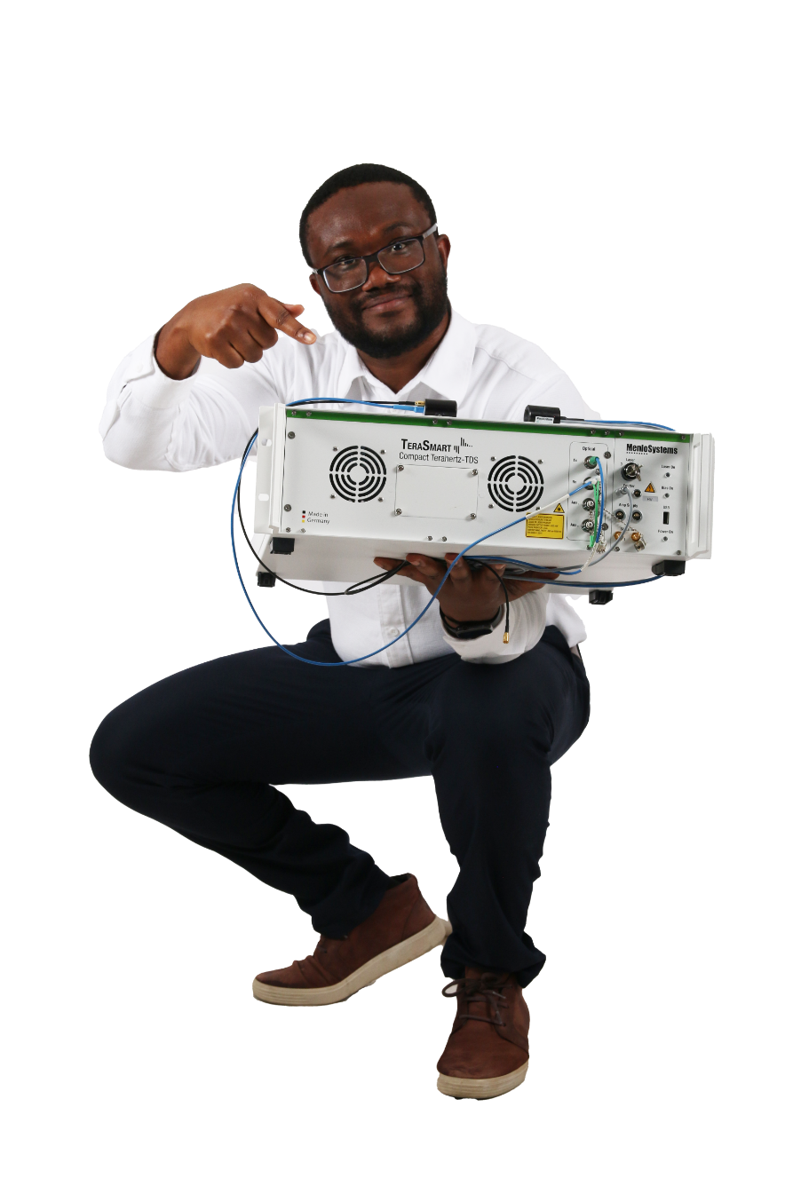
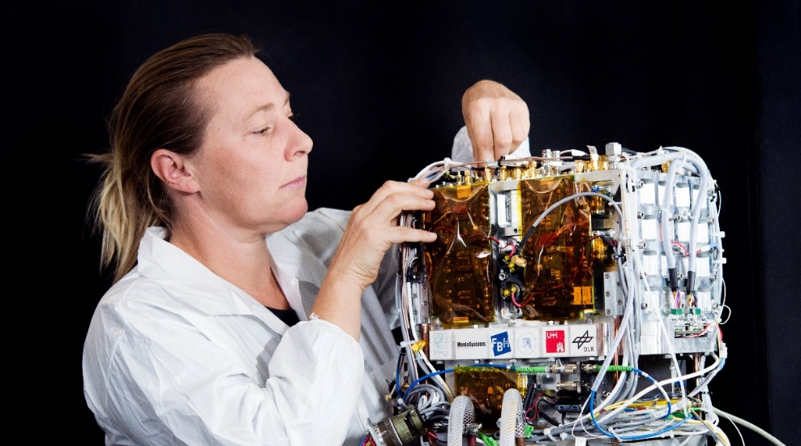
How to Communicate Your Technical Background to Industry
Final thoughts / advice
Don’t be afraid to apply, even if you think you don’t meet 100% of requirements
  Take chances!
Think of the interview as an opportunity for both sides to get to know each other
Decisions don’t have to be “forever” decisions
Ask for advice from as many people as possible
You have a lot to offer!

Slide 9
Dr. Gabrielle Thomas
g.thomas@menlosystems.com

