Slide 1

“What Recruiters Notice First: CV Mistakes, Red Flags and Quick Wins.”
Paul Verheijden – Orion Engineering - “What Recruiters Notice First: CV Mistakes, Red Flags and Quick Wins.”

Slide 2
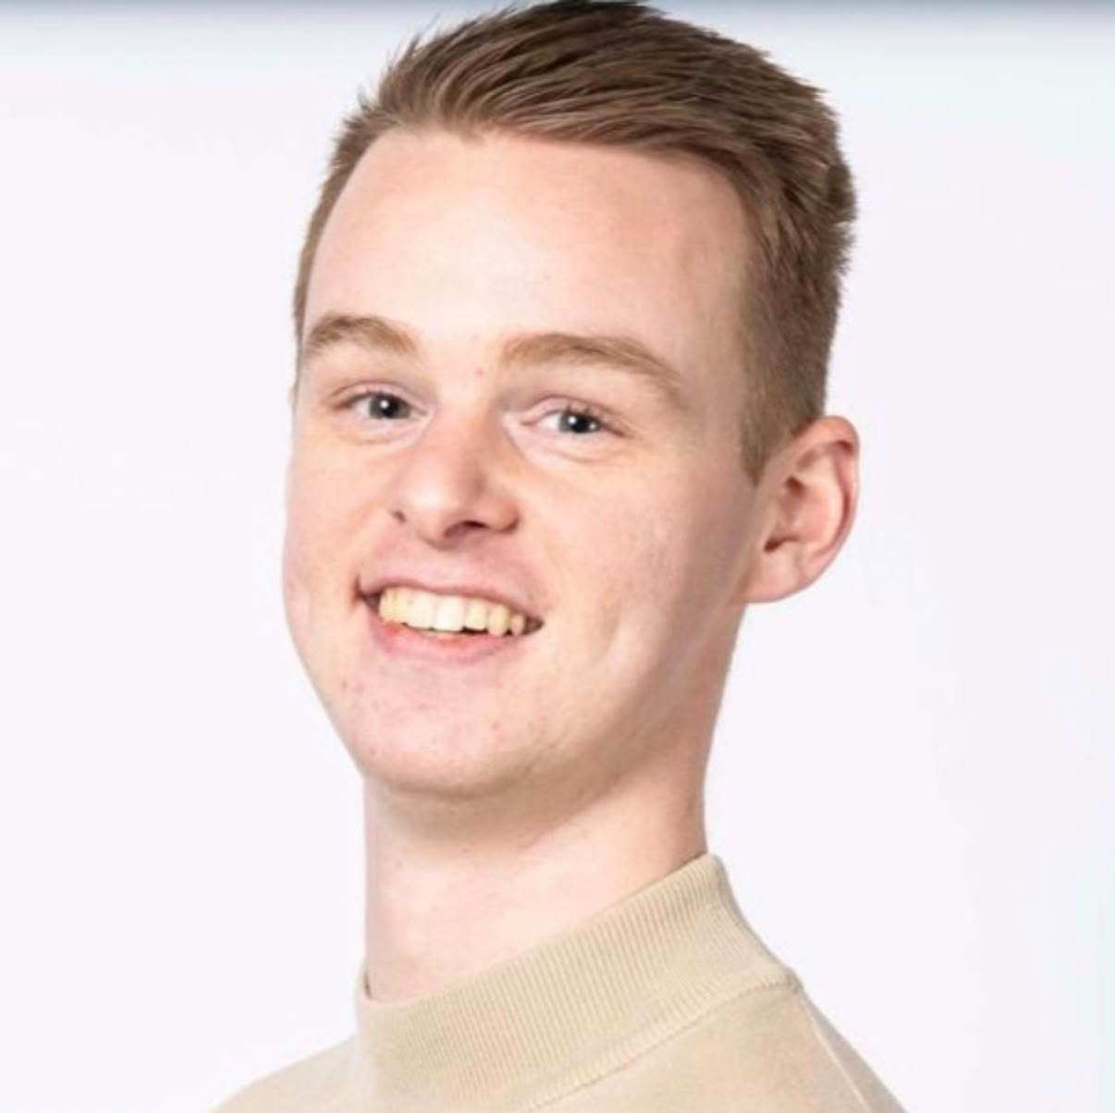
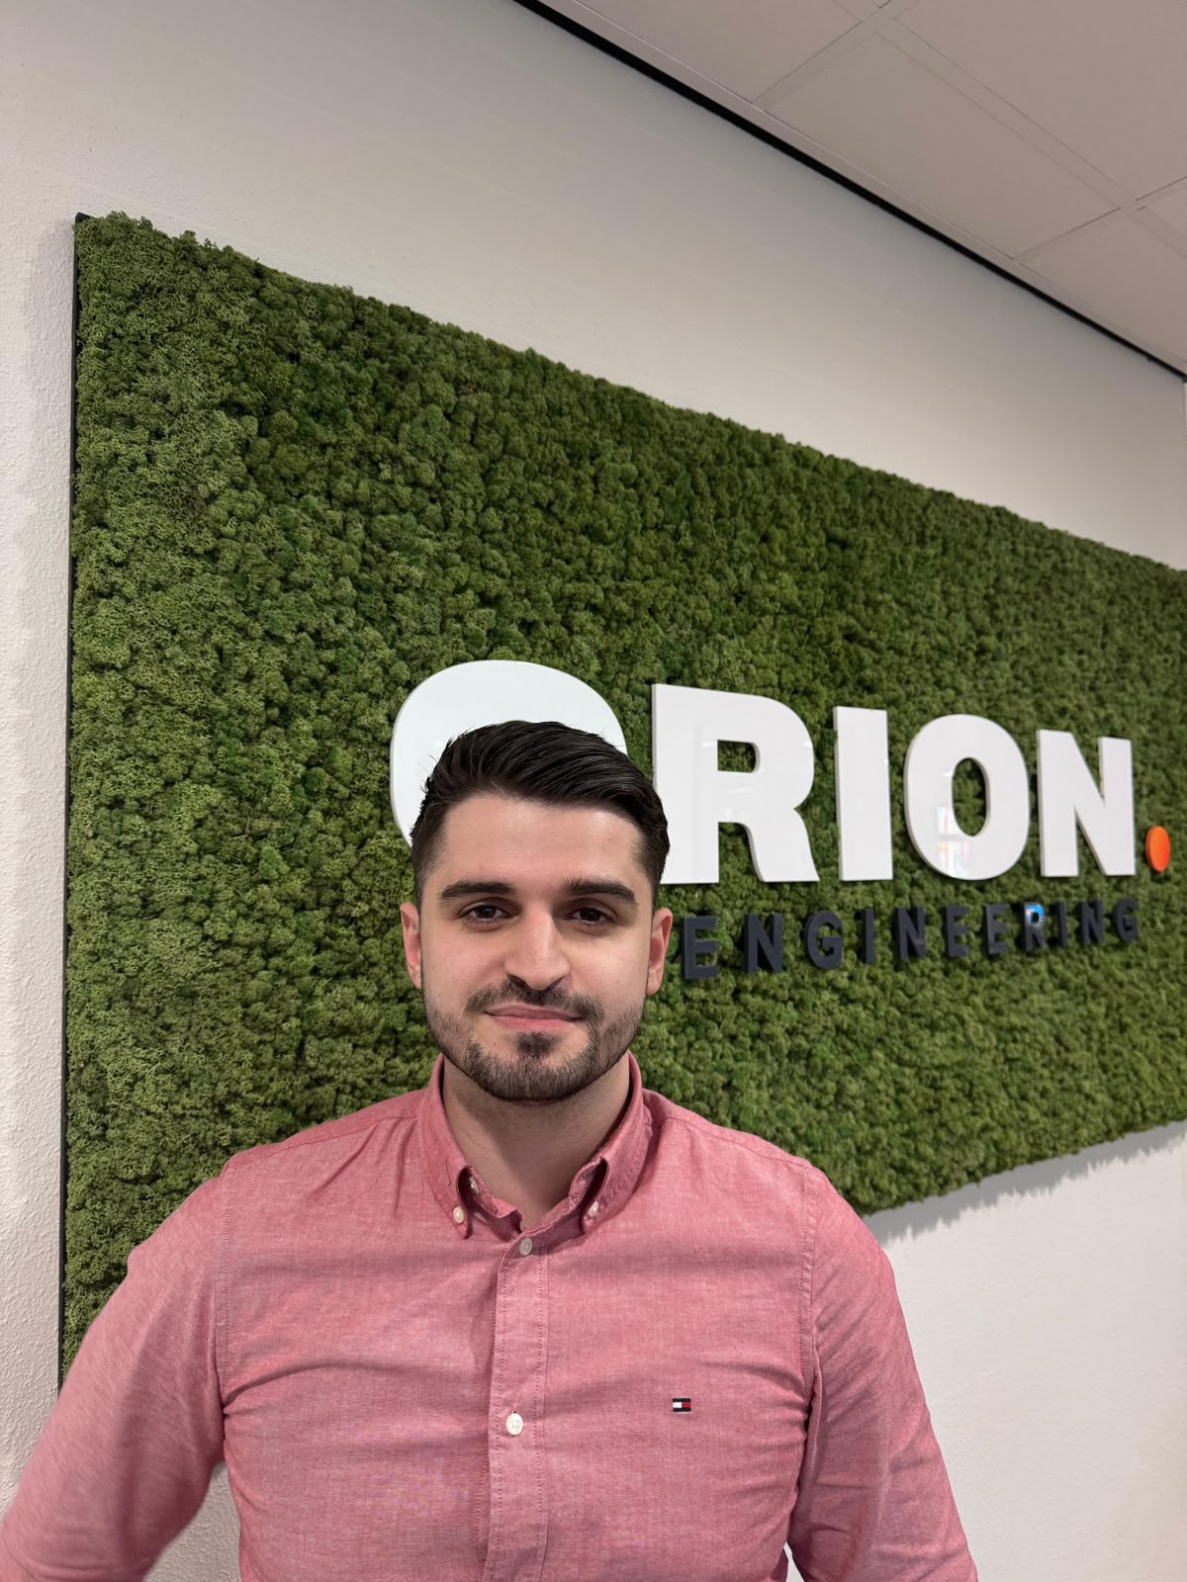
INTRODUCTION
Paul Verheijden
Senior Business Manager
Adem Rama
Business Manager
Paul Verheijden – Orion Engineering - “What Recruiters Notice First: CV Mistakes, Red Flags and Quick Wins.”

Slide 3

Let’s make it interactive…
What do you think managers or recruiters will notice first on a CV?
What do you think they will pay attention to the most?
Adem Rama – Orion Engineering - “What Recruiters Notice First: CV Mistakes, Red Flags and Quick Wins.”

Slide 4

What a manager or recruiter really will look at
Study direction
Duration of the study
Thesis and/or internship
Programs/Tools used
Adem Rama – Orion Engineering - “What Recruiters Notice First: CV Mistakes, Red Flags and Quick Wins.”

Slide 5
Let’s interact again!
Which of these two CVs you think is a good CV?
CV 1 CV 2
Adem Rama – Orion Engineering - “What Recruiters Notice First: CV Mistakes, Red Flags and Quick Wins.”

Slide 6
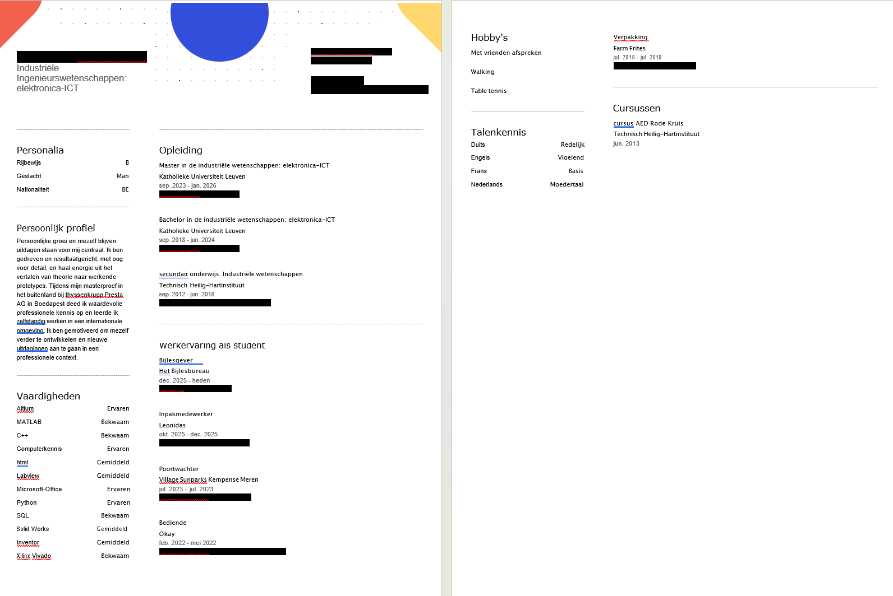
Adem Rama – Orion Engineering - “What Recruiters Notice First: CV Mistakes, Red Flags and Quick Wins.”

Slide 7
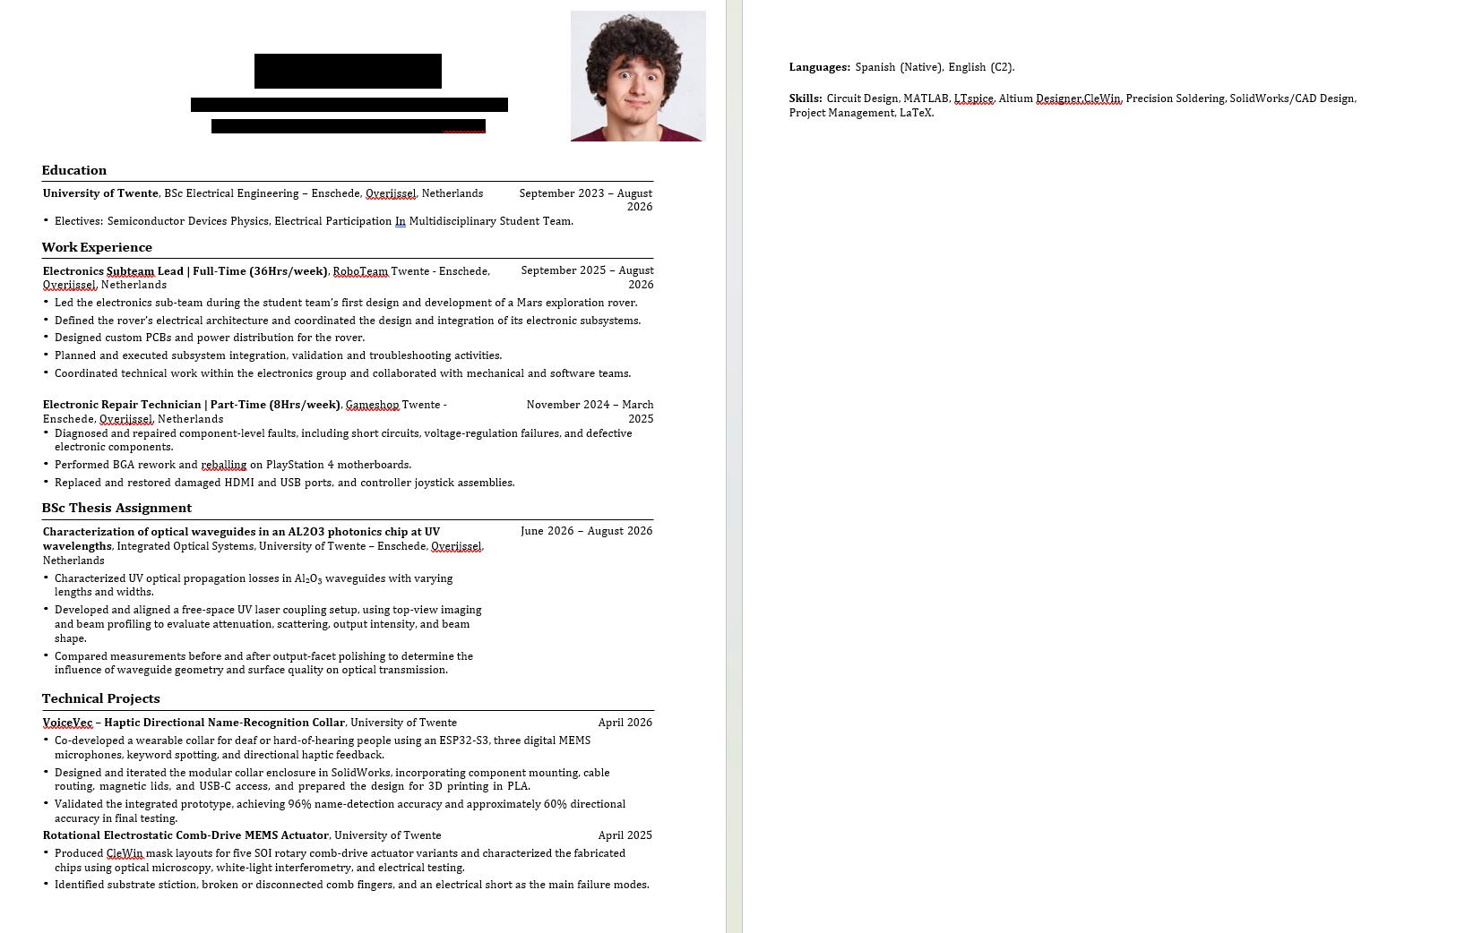
Adem Rama – Orion Engineering - “What Recruiters Notice First: CV Mistakes, Red Flags and Quick Wins.”

Slide 8
The Red Flags & Quick Wins
RED FLAGS
Unclear or overly long CV
Generic profile without focus
QUICK WINS
Tailor your CV to the position
Start with a clear professional summary
Use relevant keywords and tools
Keep the structure clean and consistent
Check spelling, dates and contact details
Adem Rama – Orion Engineering - “What Recruiters Notice First: CV Mistakes, Red Flags and Quick Wins.”

Slide 9

TIPS & TRICKS TO COME WELL PREPARED FOR AN INTERVIEW
Be able to introduce yourself in 3 minutes
Why are you a good fit for this position?
What do you expect to be doing in this position?
Why do you want to work in this position and for this company?
What are your strenghts and where could you develop?
What problems did you encounter, and what did you do to solve them?
Prepare questions to ask to the interviewer
PRO TIP: Make a presentation about you and your thesis!
Paul Verheijden – Orion Engineering - “What Recruiters Notice First: CV Mistakes, Red Flags and Quick Wins.”

Slide 10
Thank you for your attention.
Feel free to ask any question!
Paul Verheijden – Orion Engineering - “What Recruiters Notice First: CV Mistakes, Red Flags and Quick Wins.”

