Slide 1
EPIC Online Technology Meeting on Laser-based
Semiconductor Processing
Infrared solutions for your applications Jerzy Łach June 2020
Notes:
Welcome everyone, Im glad i can be here.
I’d like to introduce myself. I’m John Doe from Doe international.
What I'd like to present to you today is ...

Slide 2
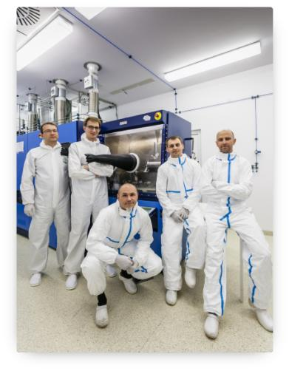
ABOUT US
// Key competitive advantages
VIGO System supplies a wide range of products for photonics. Our offer includes both epitaxial semiconductor materials as well as infrared detectors and detection modules. All products are based on our own unique technology.
Our competitive advantage is based on:
Over 30 years of experience in detector manufacturing
The best quality to price ratio
Ability to meet the highest quality requirements (NASA, military)
Main supplier for detectors for QCL
> 150 employees (1 professor, 14 PhDs and >50 engineers)
6500 m² of production area
// Our strengths
TECHNOLOGY Unique technology, established internally and continuously developed, allowing production of sophisticated optoelectronics sensors
PEOPLE Highly educated and experienced personnel
MARKET KNOWLEDGE Numerous group of satisfied customers. Wide network of distributors
INNOVATION Close co-operation with academia and R&D institutions allowing for highly advanced research. Ability to recruit highly competitive staff
EPIC Online Technology Meeting on Laser-based Semiconductor Processing Jerzy Łach
Notes:
First of all I’ll…
TECHNOLOGY. Unique technology, established internally and continuously developed, allowing production of the most sophisticated optoelectronics sensors, outmatching rival companies. Flexibility and ability to customize every product to each client needs. Own R&D laboratory allowing development of technology and products.
PEOPLE. Highly educated and experienced personnel. Friendly atmosphere promoting creativity and innovation. Workplace allowing work-life balance.
MARKET KNOWLEDGE. Numerous group of satisfied customers. Wide network of distributors on European, American and Asian markets. Very good image on global detector market.
INNOVATION. Close co-operation with academia and R&D institutions allowing for highly advanced research. Ability to recruit highly competitive staff.

Slide 3
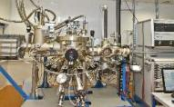
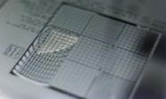
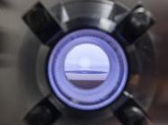
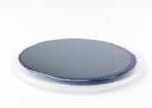
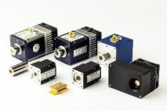
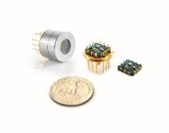
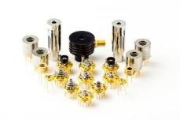
Verticaly integrated manufacturer of Mid IR components
// Complete production line for infrared semiconductors and Mid IR photonic devices
1. Epitaxy → 2. Processing
Growth of MCT and III-V semiconductor layers in MOCVD and MBE technology
Contact and passivation deposition, dry and wet etching and photolithography
Production of high quality epitaxial heterostructures from materials of group III-V. GaAs and InP based products.
Preparation of structures for assembly: dicing, wirebonding and flip-chip
←
Dedicated electronics for each type of infrared detector
Microlenses monolithically integrated with the active structures
Integration of infrared detector with electronics in common packages. Complete detection modules
Automated assembly, hermetization and packaging
4. Integration with electronics ← 3. Detectors packaging
Notes:
Mesurements are alsow carried out by our production team

Slide 4
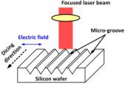
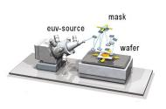
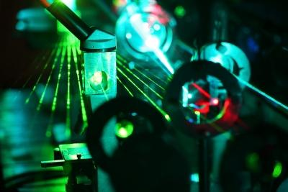
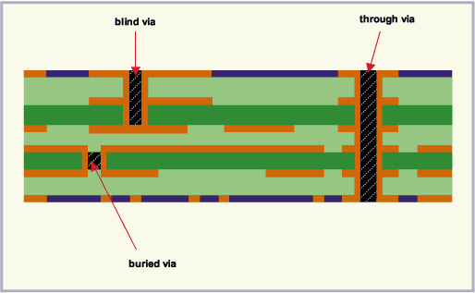
Laser Semiconductor & PCB Processing Applications
// Wafer processing - laser parameters measurement
Dicing, milling – laser parameters monitoring
Etching - fast semiconductor surface temperature measurement
UV/EUV lithography – laser beam measurement
Fast laser pulse measurement
Laser beam positioning
PCB via hole laser testing

Slide 5
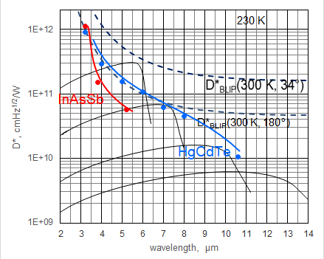
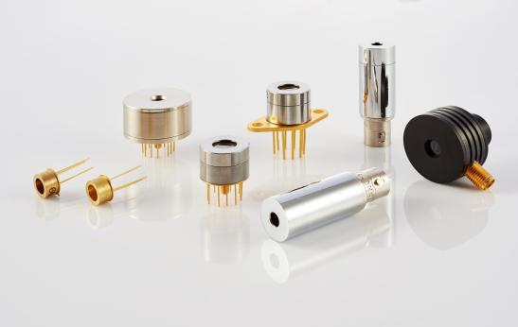
Opportunities For IR Detectors In Laser &PCB Processing
// Parameters vs fundamental limits
// Detectivity approaching fundamental limits of performance
Time response aproaching GHz range
Notes:
We produce a large veraiety of detectors, like PC PV PVM (PV Multijunction) PEM (photoelectromagnetic) or quadranst. from near to far infrared
Hiperhemisferyczna soczewka ograniczony kąt promieniowania

Slide 6
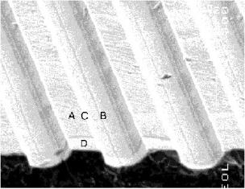
INFRARED DETECTORS
Photovoltaic multiple junction detectors PVM and quadrant geometry detectors
// Features
Wide spectral range from 2 to 12 µm
Large active areas up to 4×4 mm²
No bias required
No 1/f noise
Short time constant ≤ 1.5 ns
Operation from DC to high frequency
Radiation polarization sensitive
Uncooled and TE cooled
PVM / PVMI series
1 – 13 µm HgCdTe
ambient temperature
PVM-2TE / PVMI-2TE series
1 – 13 µm HgCdTe
two-stage thermoelectrically cooled
PVMQ
1 – 12 µm HgCdTe
ambient temperature
PVMI-3TE series
1 – 13 µm HgCdTe
three-stage thermoelectrically cooled
PVMI-4TE series
1 – 14 µm HgCdTe
four-stage thermoelectrically cooled

Slide 7
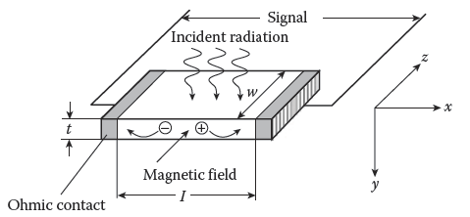
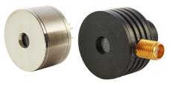
INFRARED DETECTORS
Photoelectromagnetic detectors PEM
// Principle of operation
// Features
Room temperature operation
No bias required
No 1/f noise
Large active areas up to 2×2 mm²
Very fast response (time constant ≤1.2 ns)
Sensitive to radiation polarisation
A. Rogalski. Infrared Detectors. CRC Press, Boca Raton, FL, Second edition, 2011
PEM / PEMI series
2 – 12 µm HgCdTe
ambient temperature

Slide 8
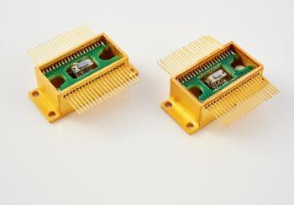
VIGO System – NEW PRODUCT LINE
// MWIR/LWIR HgCdTe and InAsSb linear arrays
Features
High sensitivity
High-speed response
From DC to a few MHz
Low drift of output signals
Compact, small size and weight packages
Convenient cryogenic-free operation
Customizable array formats, spectral range, responsivity and signal processing circuits
Array format | linear or bilinear, up to 32 elements
Pixel size | minimum 25×25 μm
Detector material | HgCdTe or InAsSb
Detector type | PV or PC
Cut-off wavelength | 3 to 14 µm
Cooling | 1 to 4-stage TEC
Time constant | 1 ns – 10 µs
Active elements temperature | 210 – 270 K
Temperature sensors | thermistor or diode
Package | TO8 16-pin or butterfly 40-pin
Window | Si/Al₂O₃/Ge/ZnSe with or w/o AR coating, planar or wedged
Ambient temperature | -20 to 70°C
Storage temperature | -20 to 50°C

Slide 9
Contact us:
VIGO System S.A.
ul. Poznańska 129/133
05-850 Ożarów Mazowiecki
POLAND
phone.: +48 22 733 54 10
fax: +48 22 665 21 55
email: info@vigo.com.pl
Notes:
Thank u for your attension.
I wish you all good health and take care.
What we can do for you?
Supply optoelectronic products that meet you requirements.
Common projects.
Cooperation.
// What you can do for us?
Zapraszamy do współpracy

