Slide 1
Fiber Laser for PCB Applications
SIOM, member of China Academy of Sience
FEIBO Laser Technologies, Shanghai
HIGHLIGHT Laser Technologies, Nanjing
RayScience Opto-electronics Corp., Suqian

Slide 2
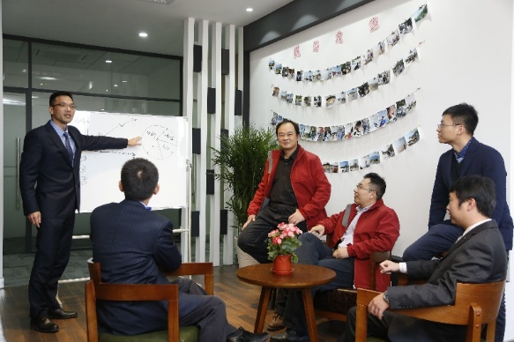
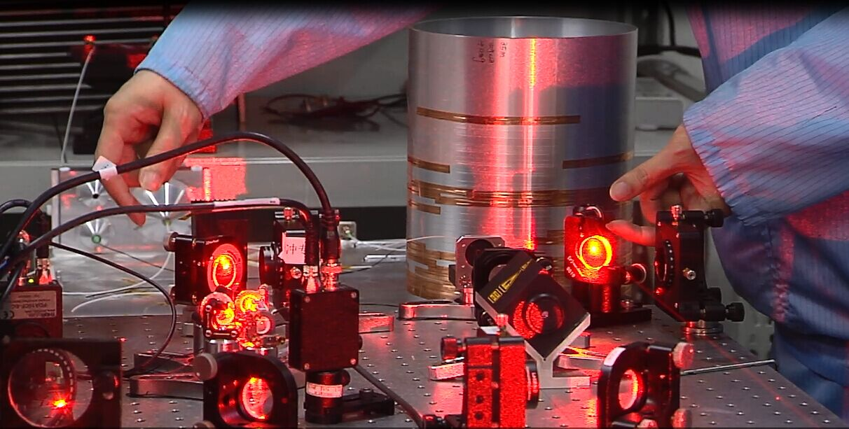
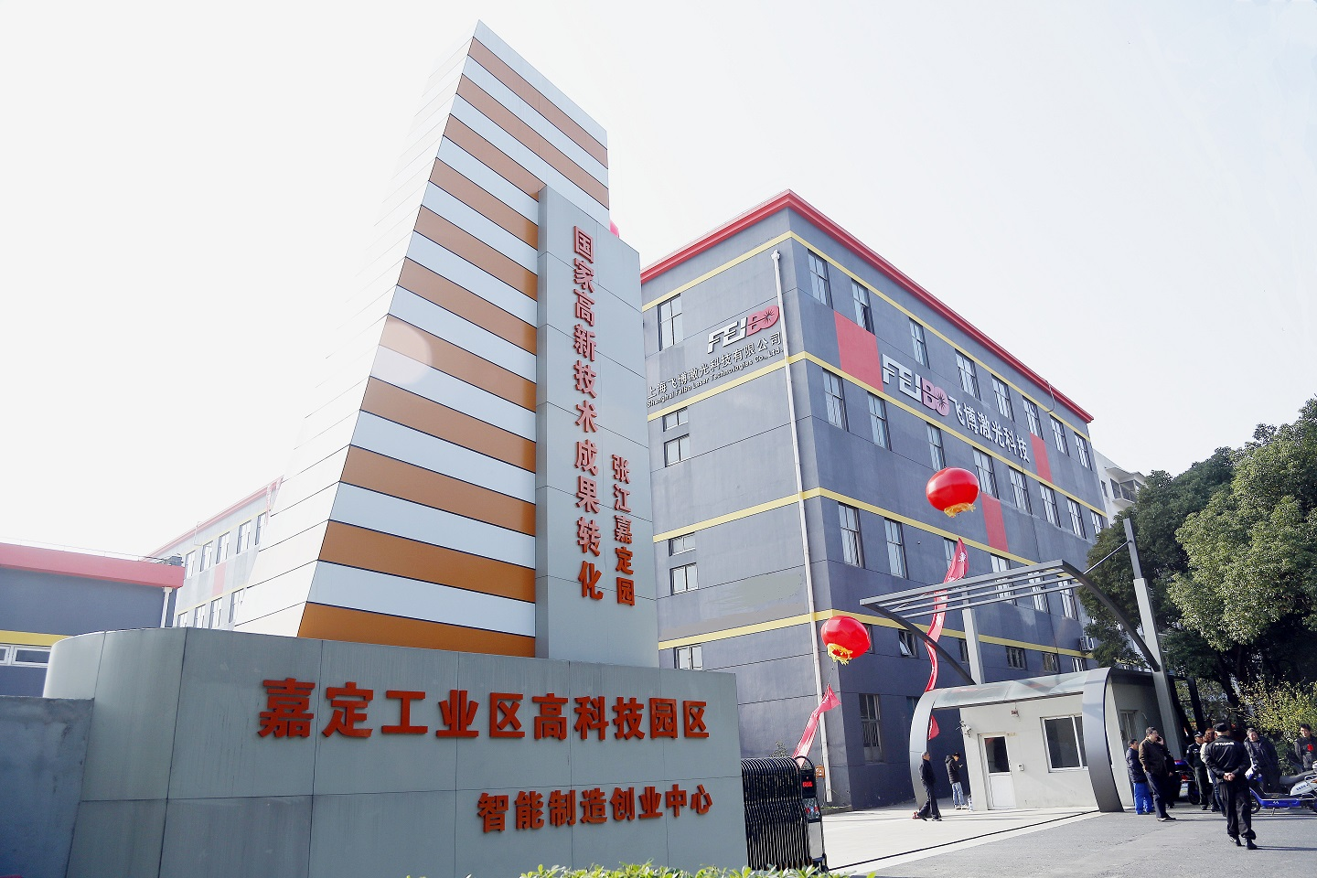
COMPANY PROFILE
Founded in 2012, FEIBO has steadily grown and innovated to become a leading supplier of high-performance laser products and quality assurance solutions in China.
200+ employees with 50+ engineers
2 factories in China, headquartered in Shanghai
7300 m2 of cleanroom space
6000+ medium to high power fiber lasers delivered
Serving industrial, scientific research and medical markets

Slide 3
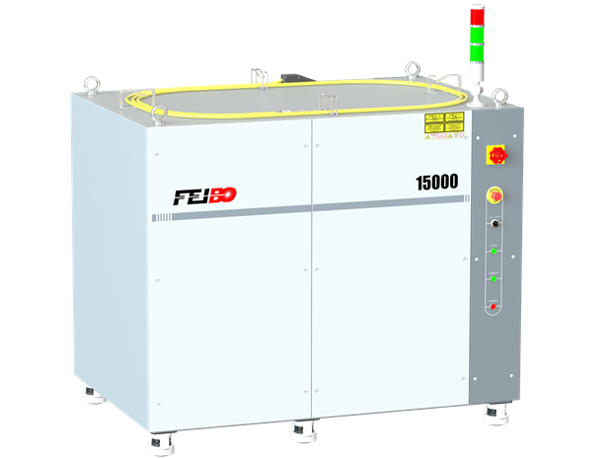
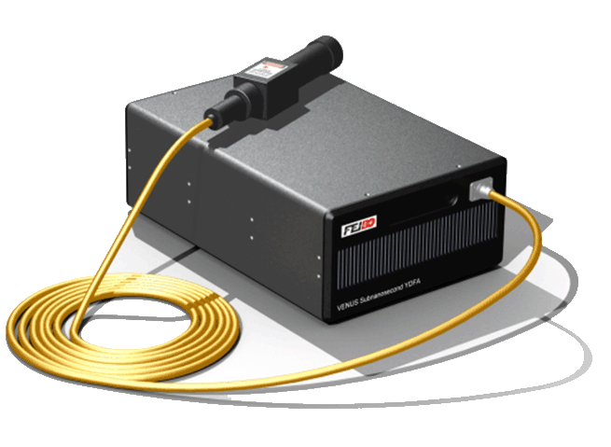
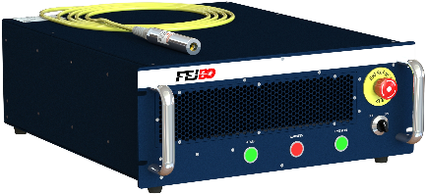
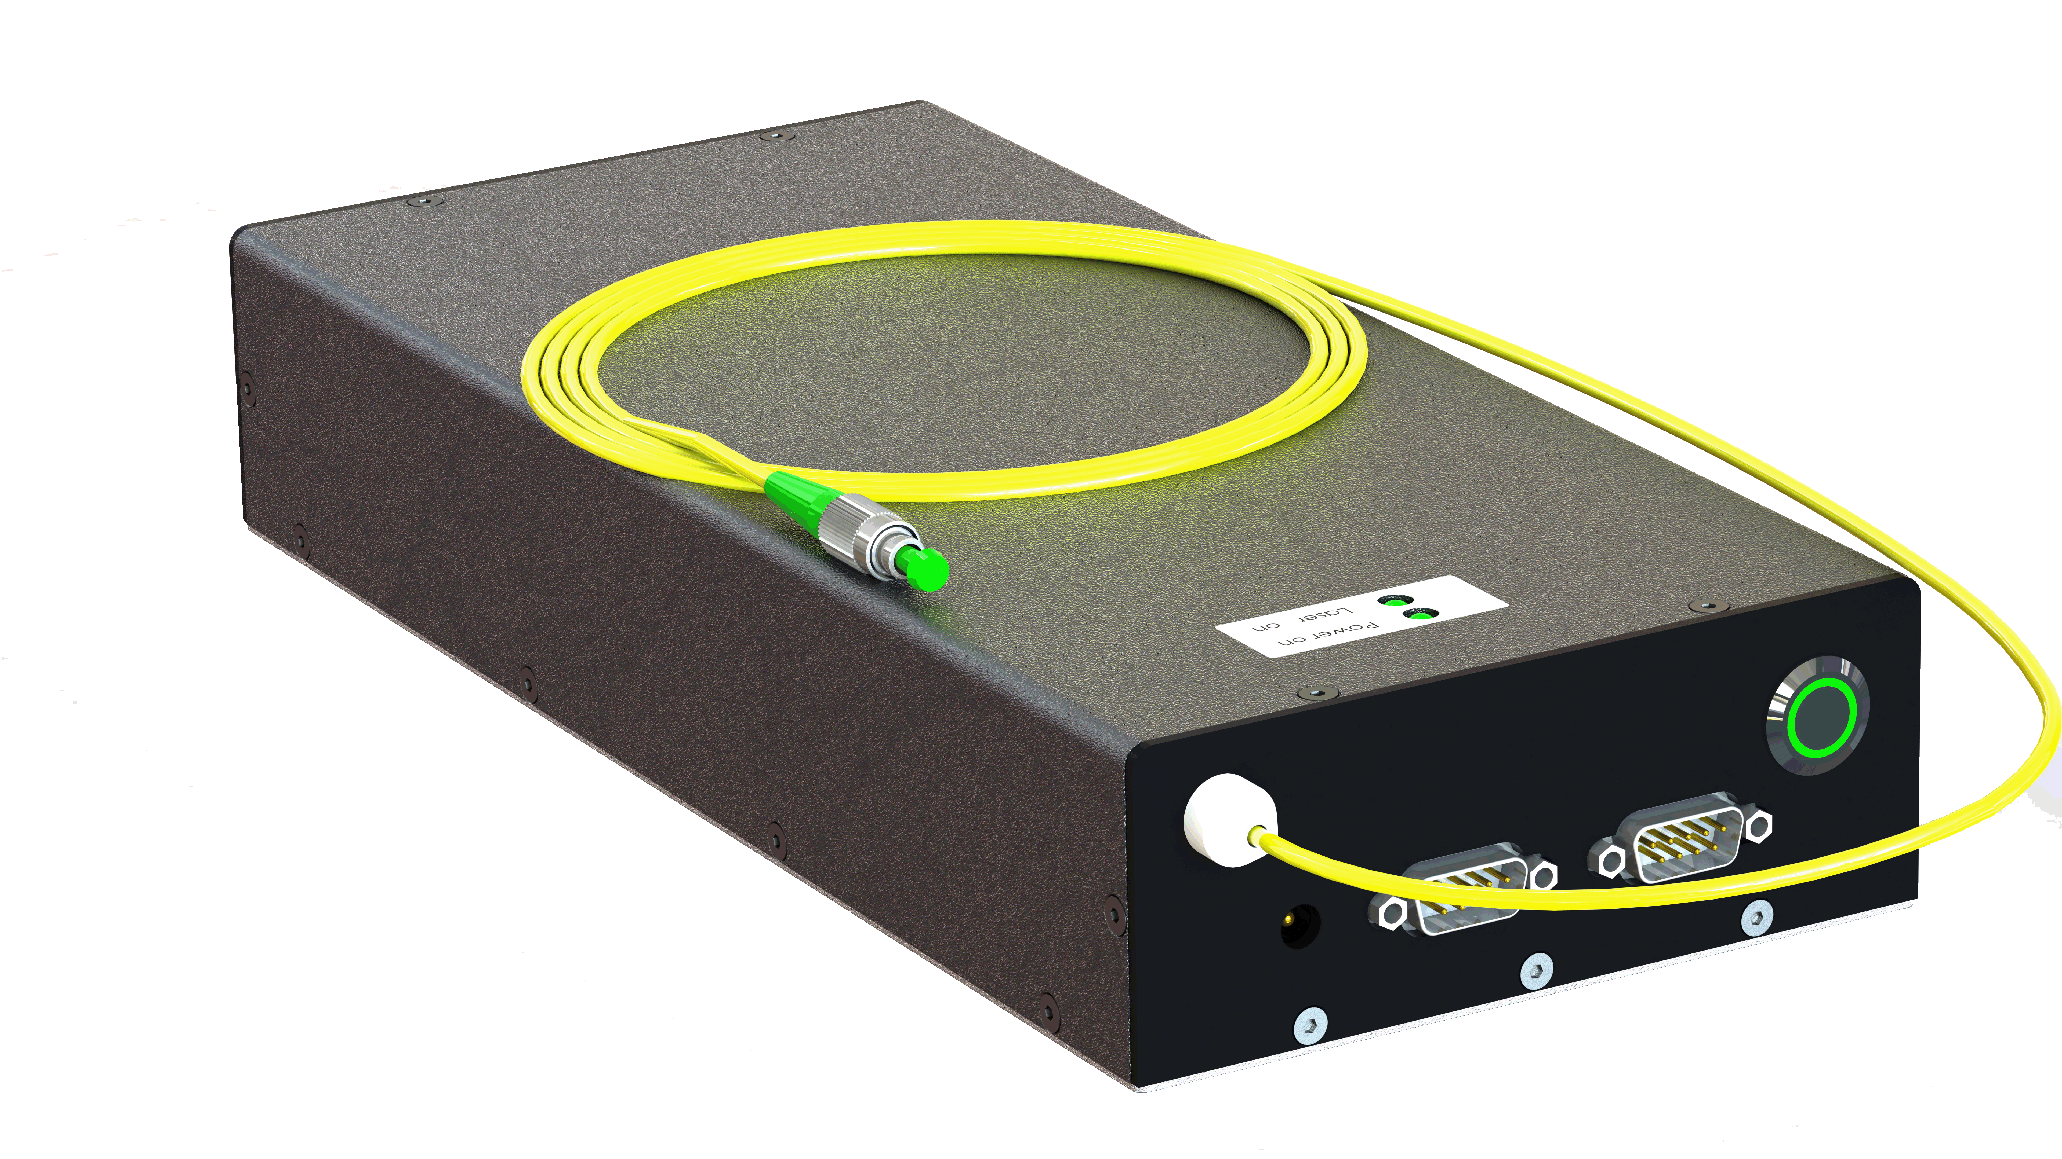
Nanosecond Pulsed
Multi-kW CW YDFL
Pulse-width Tunable Pulsed FL
Sub-nanosecond
Pulsed
Linear Polarized
Multi-kW CW
Key Specs:
Central Wavelength: 1070~1090 nm
Max Average Output Power: 200W
Power Stability: < 3%
Applications:
Precision machining
Laser marking/ablation
Metal deep engraving
Laser scribing/patterning
Laser cutting/drilling
Key Specs:
Central Wavelength: 1075~1090 nm
Rated Max Output Power: 14000W
Power Stability: < 2%
Applications:
Laser cutting/drilling
Laser welding
Laser ablation/scribing
Precision machining
Laser additive manufacturing
Key Specs:
Central Wavelength: 1064nm
Average Output Power: 1W
Power Stability: < 3%
Applications:
Laser cutting/drilling
Laser welding
Laser ablation/scribing
Precision machining
Laser additive manufacturing
Key Specs:
Central Wavelength: 1064 nm
Max Average Output Power: 20W
Power Stability: < 3%
Applications:
Thin film ablation/patterning
General marking/scribing
Precision machining
Specialty marking
Frequency doubling/tripling
Key Specs:
Central Wavelength: 1064 nm
Rated Max Output Power: 1000W
Power Stability: < 3%
Applications:
Laser cutting/drilling
Laser welding
Laser ablation/scribing
Precision machining
Laser additive manufacturing

Slide 4
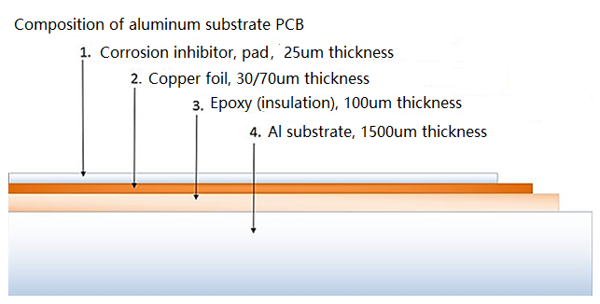
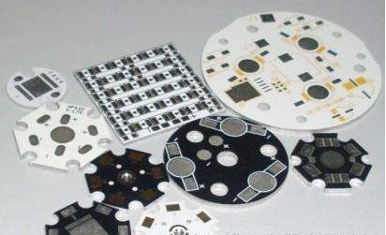
Al substrate PCB
Al substrate PCB laser cutting machine market：
More than 1000 Aluminum Based PCB manufacturers in Guangdong. estimated ~ 4000 in China.
New requirements of customers: versatile, flexible, customized, small volume order
estimated that ~ 2000 laser cutting machines will be sold within 3 years, a 150~200M euros market

Slide 5
CNC milling machine Vs laser precision cutting machine
Small initial investment: ~ 20k~30k Euros/unit
Low processing speed: ~ 3mm/s × 4 (2-4 processing heads are processed in parallel, 1.5mm plate thickness)
High cost of consumables: after processing 2-3 stacks of multilayer plates (~1 hour), the cutter head needs to be replaced
Large initial investment: ~ 70k ~ 100k Euros/unit
High processing speed: ~ 60mm/s (1 processing head, 1.5mm plate thickness)
Low cost of consumables: non-contact processing, no need to replace the cutter head, the cost of consumables can be ignored.

Slide 6
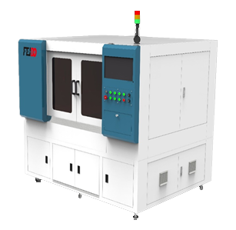
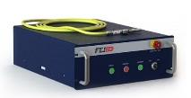
Laser processing solution for Al substrate PCB
KeyParameters | Specifications
X/Y axis working Range(mm) | 650×800; 650×600
Z axis working range(mm) | 100
Maximum positioning deviation (mm) | ±0.01
Maximum repeatability (mm) | ±0.004
X/YAxis max moving speed (m/min) | 60
Laser type | PreciCut M2/H1 CW/QCW dual mode kW Laser
Central wavelength (nm) | 1070 ~ 1090
Beam quality(M²) | < 1.3

Slide 7
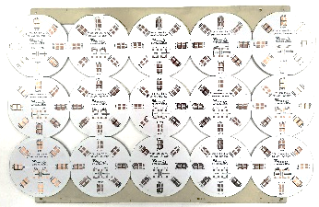
Processing cost comparison of CNC milling and laser Solution
Processing cost comparison ：Al substrate PCB with mainly small contours
Sample 1 | CNC | Laser | % Change
Processing beat (s/board) | 165 | 88 | -47%
Depreciation cost (RMB / piece) | 0.94 | 1.26 | 34%
Labor cost (RMB / piece) | 1.26 | 0.67 | -46%
Electricity cost (RMB / piece) | 0.15 | 0.19 | 27%
Consumable cost (RMB / piece) | 1.00 | 0.01 | -99%
Final Cost (RMB / piece) | 3.35 | 2.13 | -36%
Note:
1) Aluminum Based PCB board thickness 1.6mm
2) CNC milling machine: 180k RMB / set, 4 heads, Φ1.0mm cutter tool, 2-layer plate stacking processing, processing speed of 3mm / s; manual feeding and unloading, 5-year depreciation
3） Laser machine: 500k RMB/ set, single head, single layer plate processing, using PreciCut laser, average processing speed is 42mm/s; manual loading and unloading, 5 years depreciation

Slide 8
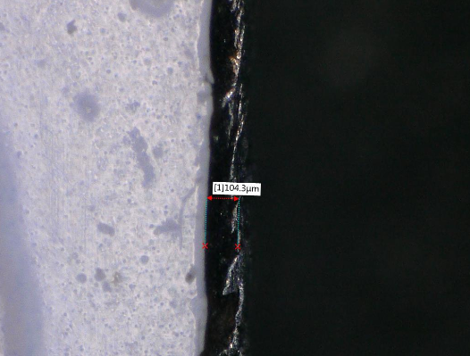
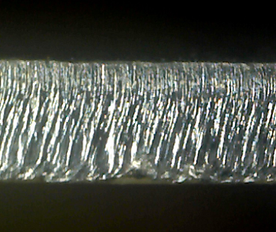
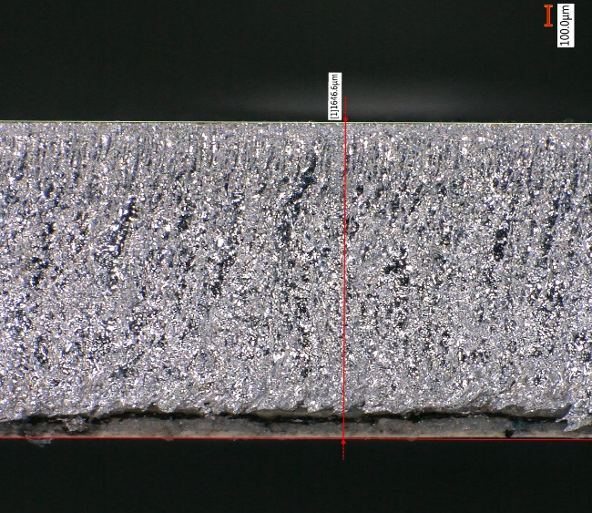
1.5kW SM CW Fiber Laser Vs. PreciCut H1
Cutting quality
Insulation thermal ablation width ~104um
Smooth cutting surface with big waves
Laser
1500W SM CW laser
Cutting quality
Insulation thermal ablation width ~ 55um
flat cutting surface with small waves; smaller micro burr
Laser
PreciCut laser
Note: cutting speed of large contour
1500W CW laser cut 1.57mm thick AL based PCB
PreciCut M2laser cut 1.65mm thick AL based PCB

Slide 9
What we can do for you?
Standard and Customized fiber laser sources
Marketing & sales channel in China
Connection to laser and laser processing community in China
What you can do for us?
Sales representatives in Europe
Joint application work addressing business opportunities in Europe & China
Specialty fibers, beam shaping optics etc.
www.feibolaser.com

