Slide 1
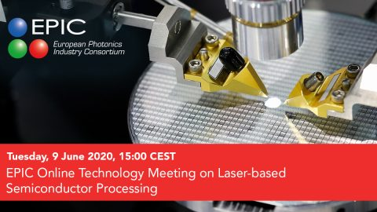
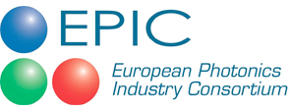
Laser microprocessing for semiconductor industry
Dr. Gediminas RAČIUKAITIS
Head of Department of Laser Technologies,
Center for Physical Science and Technology
g.raciukaitis@ftmc.lt

Slide 2
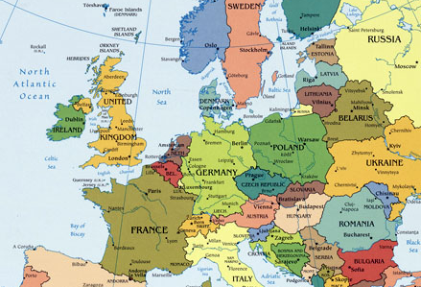
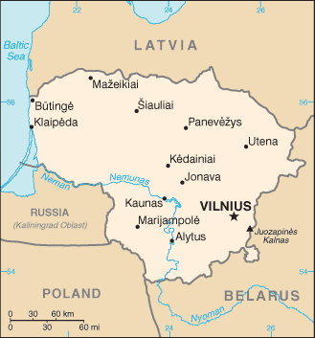
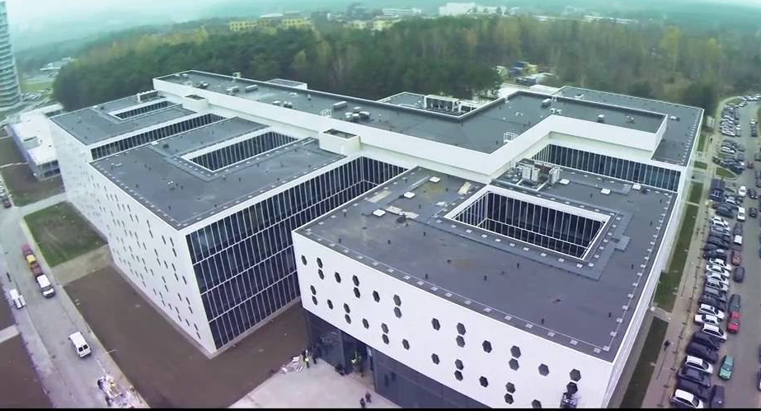
FTMC: Center for Physical Sciences and Technology
State research institute
Institute of Chemistry
Institute of Physics
Activities:
Institute of Semiconductor
Physics
Optoelectronics and laser technologies
Environmentally friendly technologies
Nuclear physics and radioecology
Organic chemistry and bio-nanotechnologies
Electrochemical materials science and technologies of functional materials
Electronics and sensors
Metrology
Fundamental research
Institute of Textile
Established in April 2010
Employees 650
Research staff 340
PhD students 100
EPIC member since 2012

Slide 3
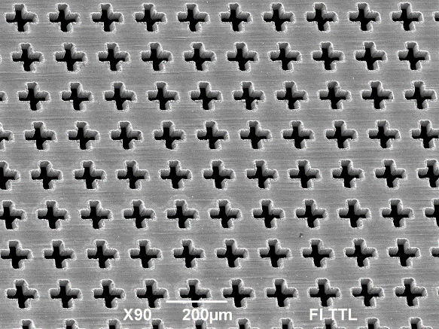
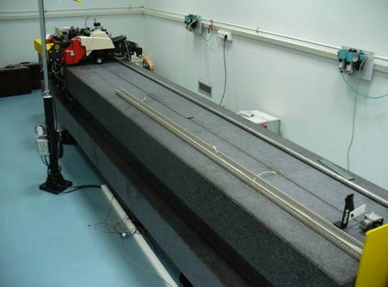
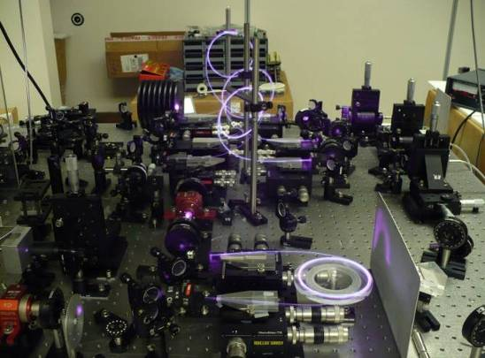
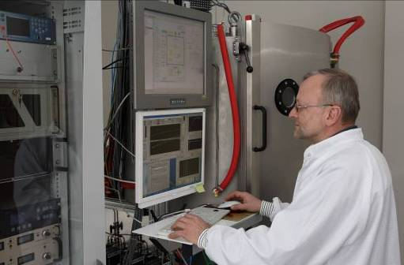
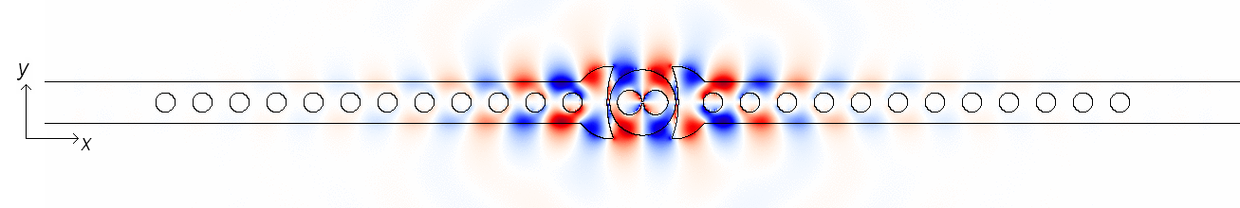
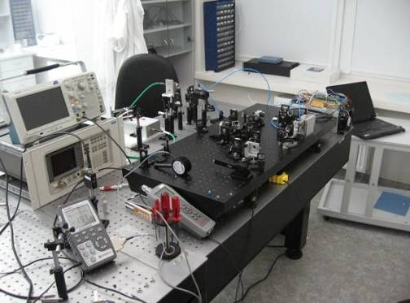
Department of Laser Technologies
1 of 18 departments at FTMC
Development & implementation of laser technologies
Laboratories:
Laser technologies (2004)
Optical coatings (2004)
Fiber lasers (2006)
Solid-state lasers (2007)
Nanophotonics (2011)
3D technologies & Robotics (2016)
Microoptical Components (2020)
Ion & e-beam sputtering
High-pulse-energy fiber lasers
Employees 75
Dr. & hab. Dr. 28
PhD students 20
Students 20
SOI photonics modelling
New design of solid-state lasers

Slide 4
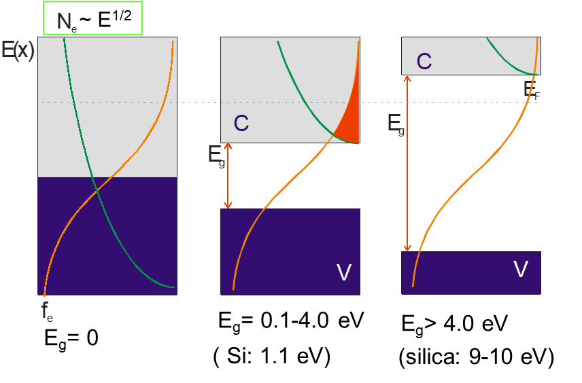
Outline
(ultra-short pulse) laser for (micro) processing of semiconductors
  laser (micro) processing of semiconductors (Si, SiC, GaAs, thin films)
  laser processing for semiconductor industry (thin film solar cells;
  laser processing for electronics
metals, semiconductors, dielectrics

Slide 5
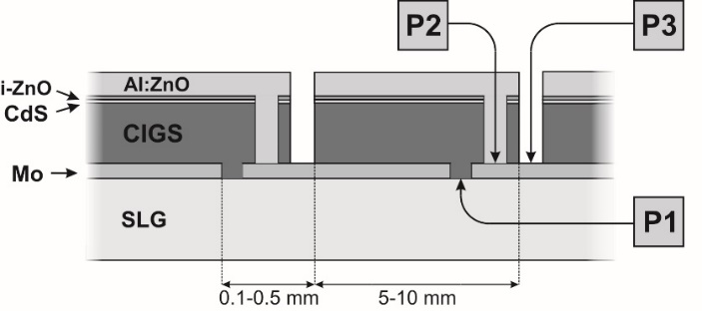
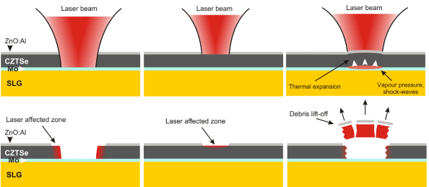
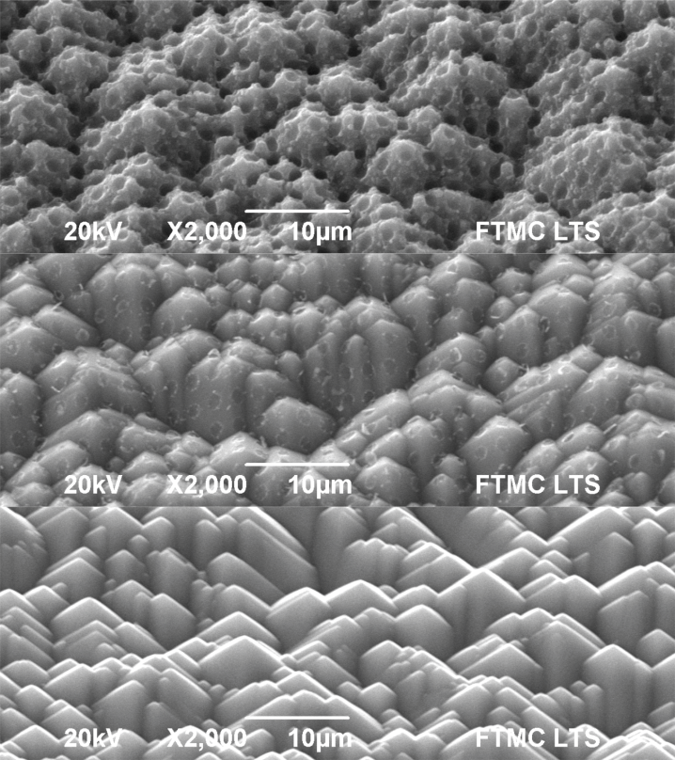
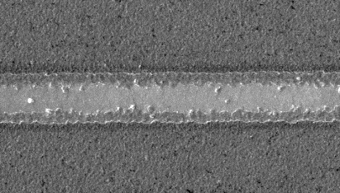
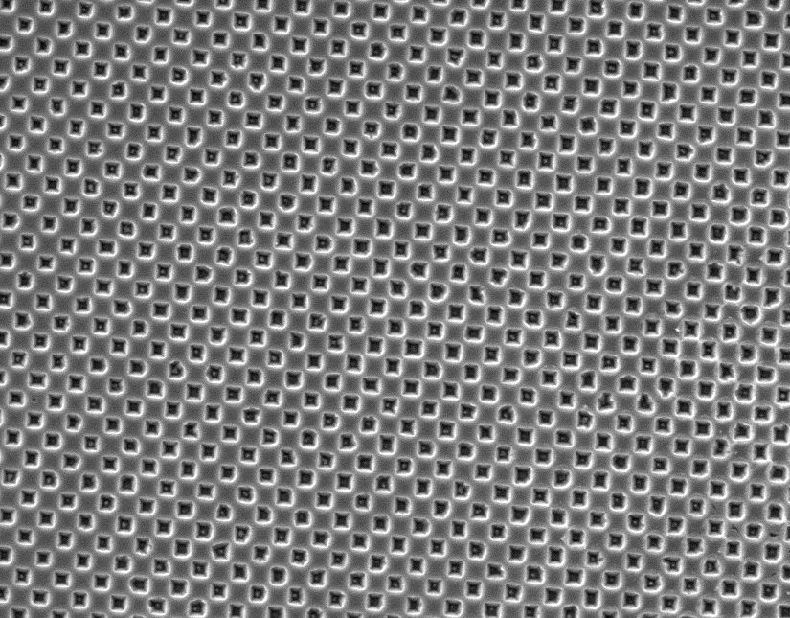

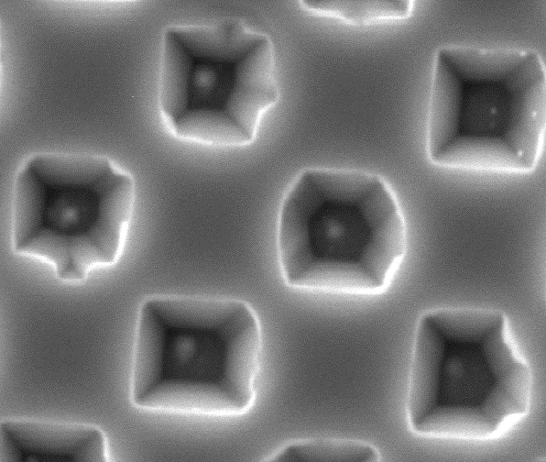
Laser processes of semiconductors: photovoltaics, THz optics
Monolithic interconnections in thin-film solar cells
For solar light harvesting in crystalline Si
1.6 J/cm²
ZnO
“Type 1“
(direct ablation)
Mo
THz optics of Si
CZTSe
Si surface nanopatterning
0.13 J/cm²
ZnO
“Type 2“
(TCO lift-off)
CZTSe
0.45 J/cm²
ZnO
Complete
Lift-off
Mo
CZTSe
+ chemistry
Notes:
Lasers have many application in production of photovoltaics elements and modules. We really advanced in development of reliable technologies for scribing CGIS and similar solar cells to make monolithical interconnections to extract photo-generated energy for the large –area cells. Another topic we work on is solar light harvesting for crystalline and multicrystalline solar cells. Innovative solutions come from combining fundamental research with approaches for high-throughput processes, needed for cheap production of PV cells.

Slide 6
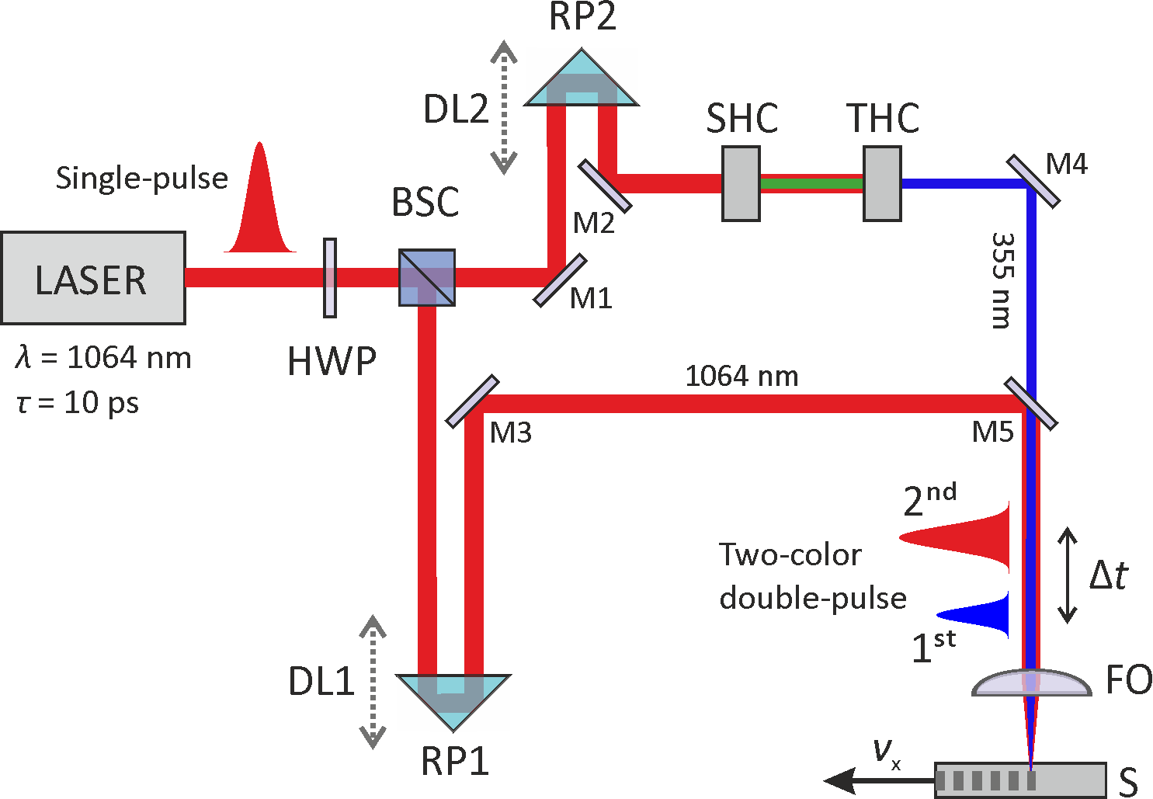
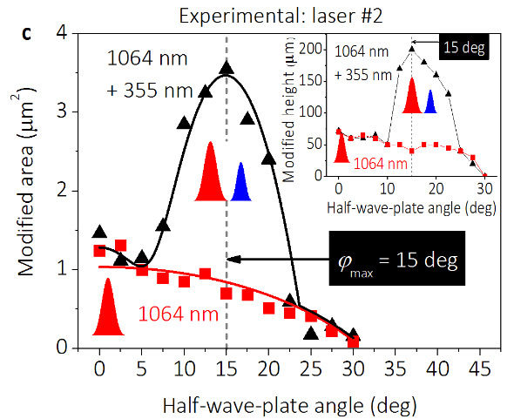
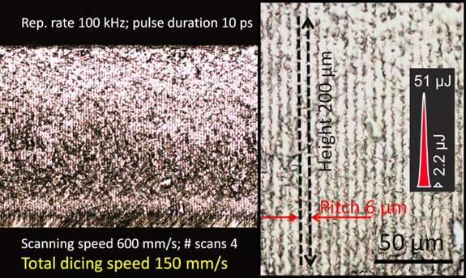
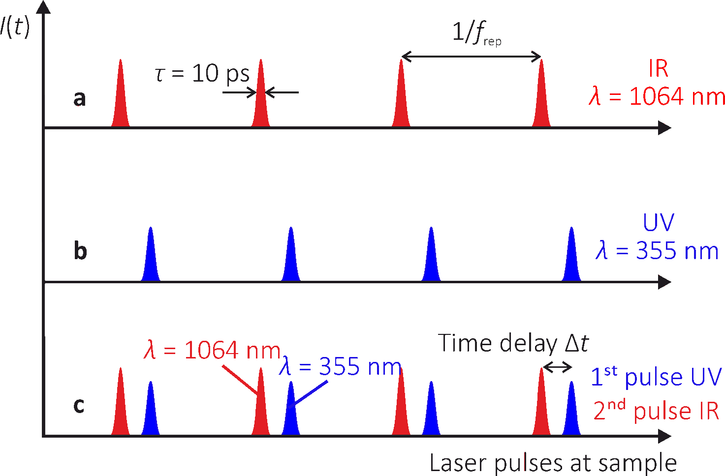
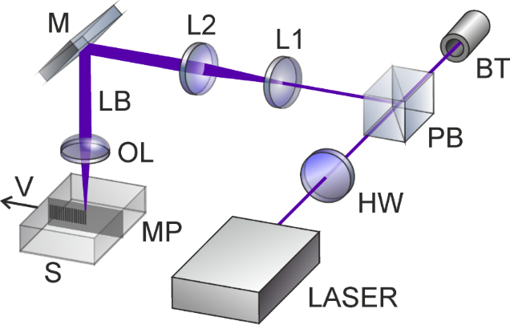
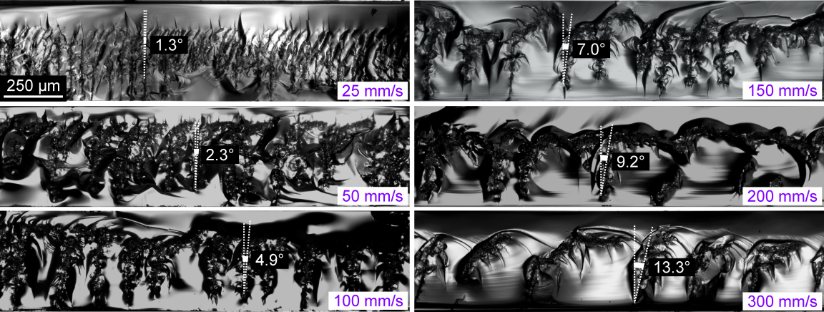
Sapphire wafer dicing for LEDs
Two-colour processing of transparent material
Modification size and pulse energy versus HWP orientation angle
dicing speed 150 mm/s @100 kHz.
Ultra-short pulse laser in burst mode

Slide 7
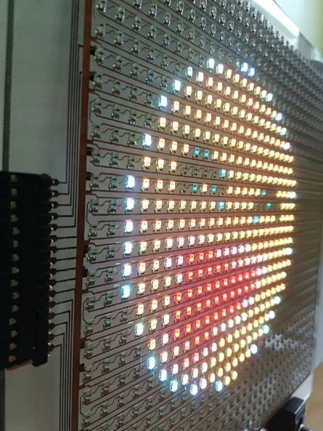
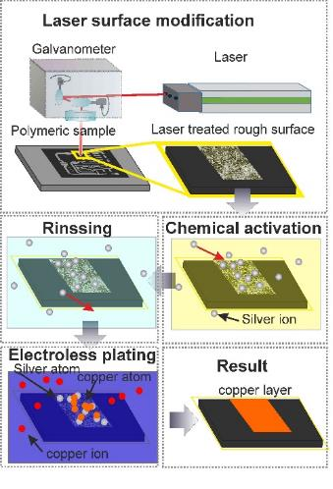
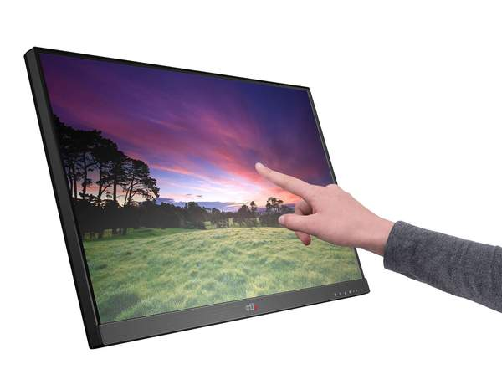
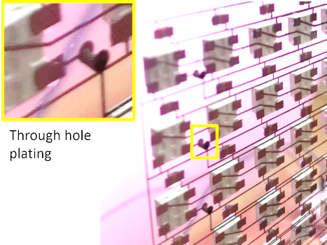
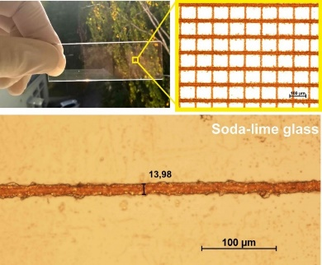
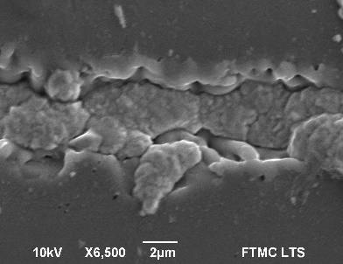
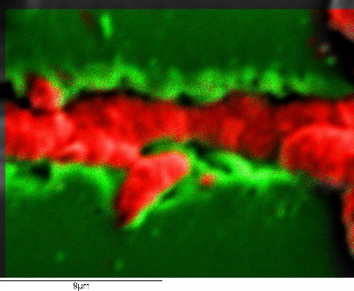
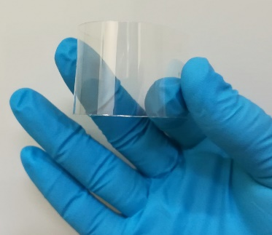
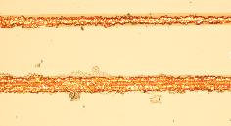
Laser-induced selective electroless metal plating
(SSAIL technology) for electronics
Laser-induced electroless metal plating on dielectrics
Process setup
Potentiality to replacement ITO for touch function
LED panel on glass
GLASS
PET
Copper
Silicon
EDS

Slide 8
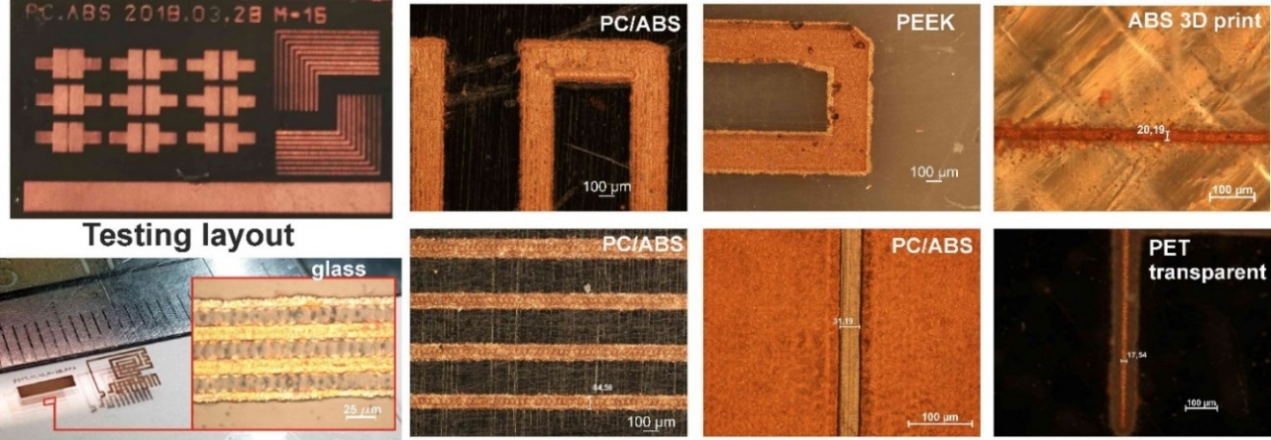
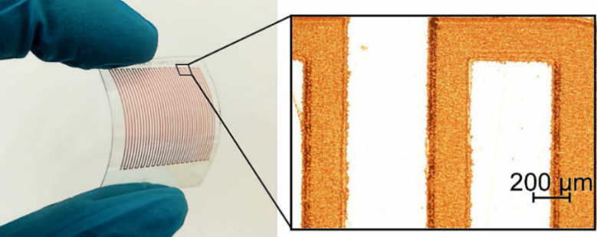

Spatial resolution of plating by SSAIL
Plating on flexible PET
Narrowest: plated line width and spacing
Plating on glass

Slide 9
Thank you for attention
&
Questions?

